Slide 1

Analysis of Marketing Channels through Customer Behavior
Andres Cojuangco

Slide 2
Agenda
Overview of Data
Channel Performance
Channel Efficiency and Customer Behavior
Opportunities for Improvement
Evaluating the Analysis

Slide 3
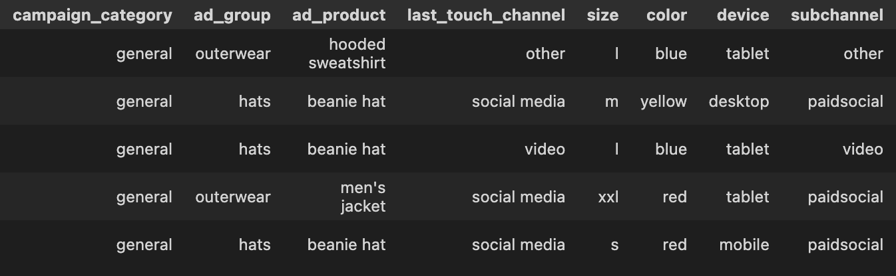
Overview of Marketing Data
Campaign Categories: General, Winter Clearance, Retail, Spring Essentials, Summer Collection
Ad groups: Outerwear, Pants, Hats, Footwear
Products: Men’s Jacket, Denim Jeans, Worker Pants, Beanie, Women’s Shoes

Slide 4
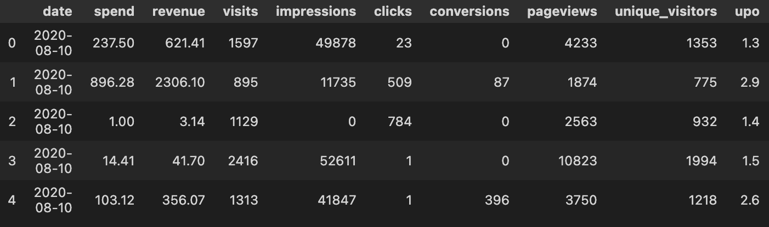
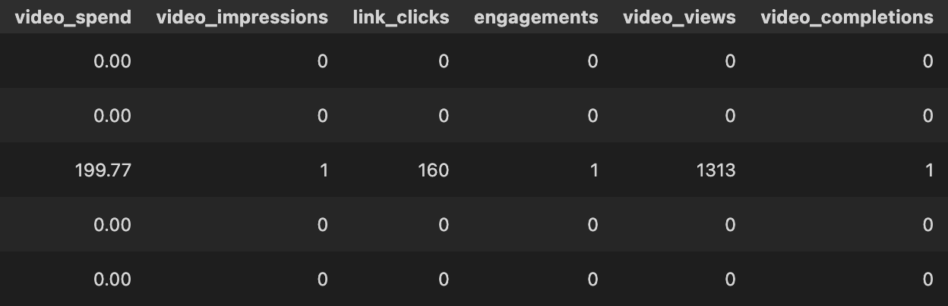

Slide 5
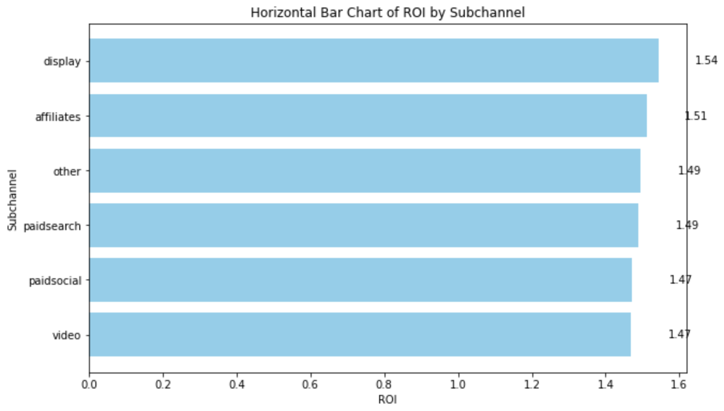
Subchannel Performance

Slide 6
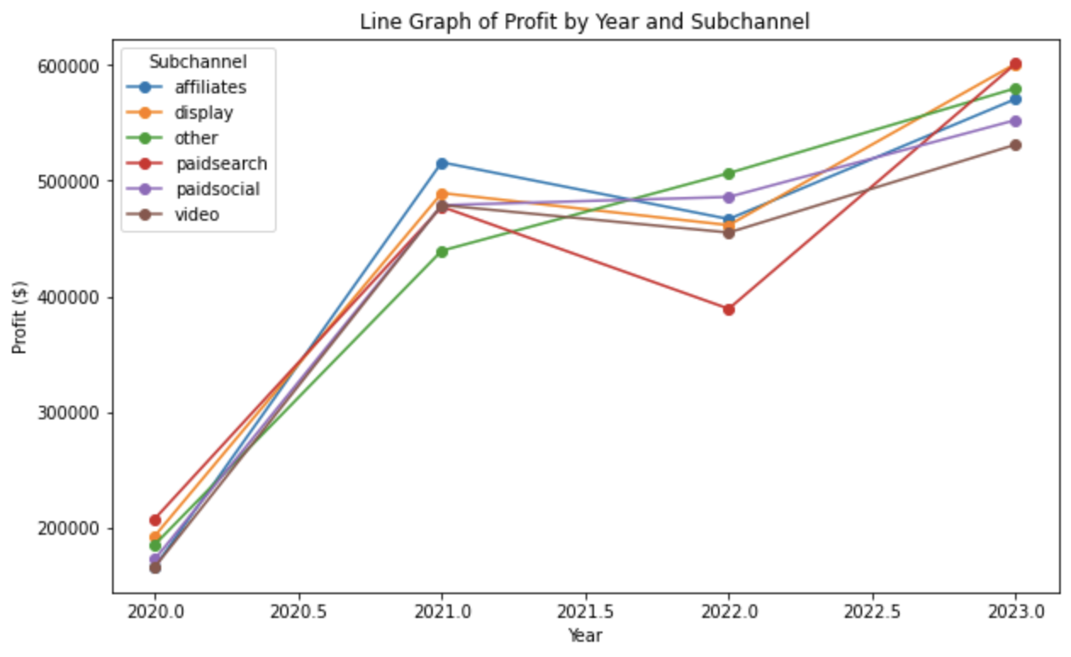
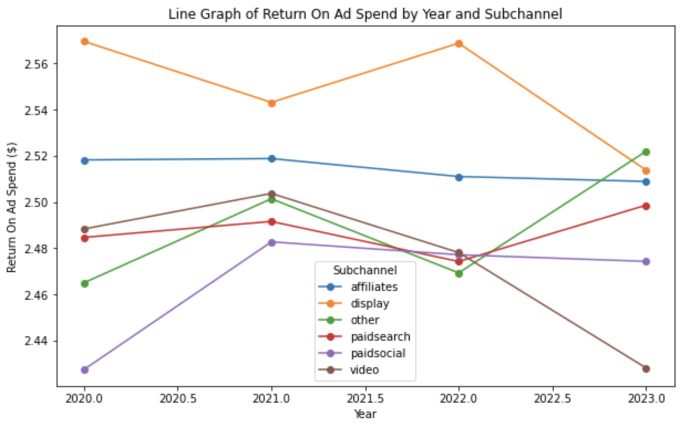
Subchannel Performance
Doubled our profits since 2020
Ad volume has greatly increased in 2023
Drops in efficiency in display subchannel and video subchannel

Slide 7

Exploring Subchannel Efficiency - Customer Metrics
Acquisition
Cost per Click or Cost per View
Click through rate or View Rate
Clicks to Visit or Video Completion Rate
Average pages per Visit or Link Click Rate
Consideration
Conversion
Conversion Rate
Return on Investment

Slide 8
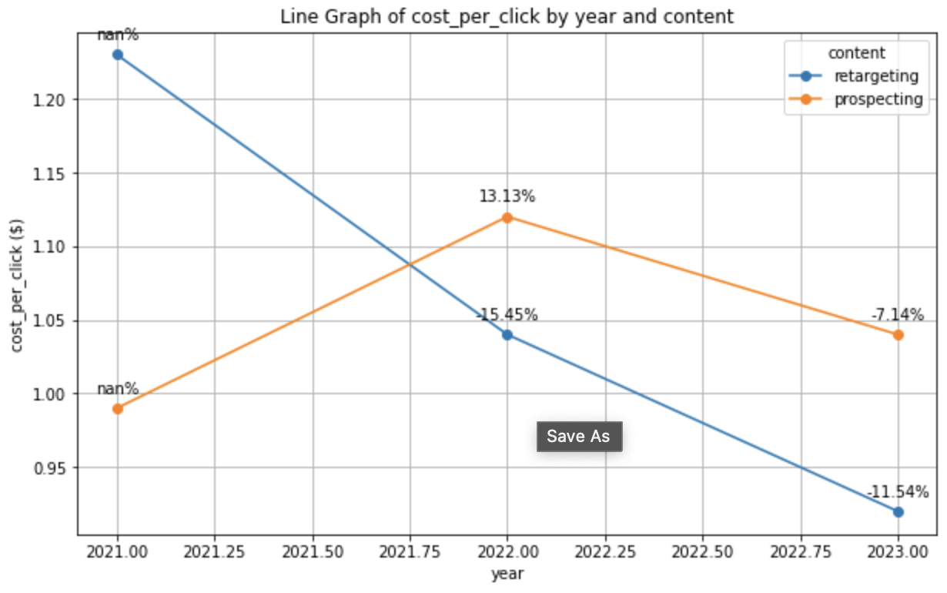
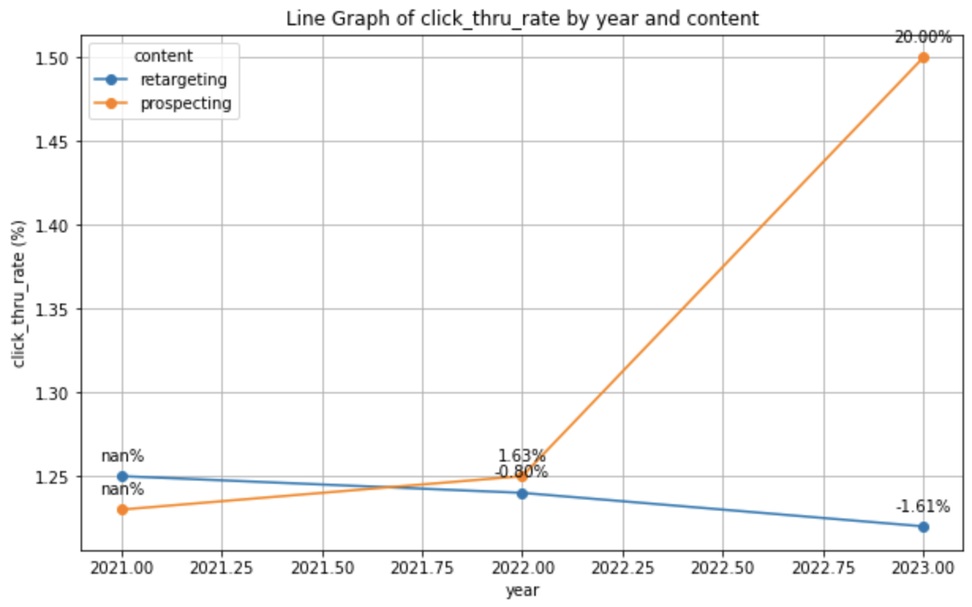
Display Subchannel - Acquisition Metrics
12 cent difference in cost per click for 2023
Around $1 per click for both content types
Prospecting ads have a higher click through rate by a little over 25%
At least 1 click per impression

Slide 9
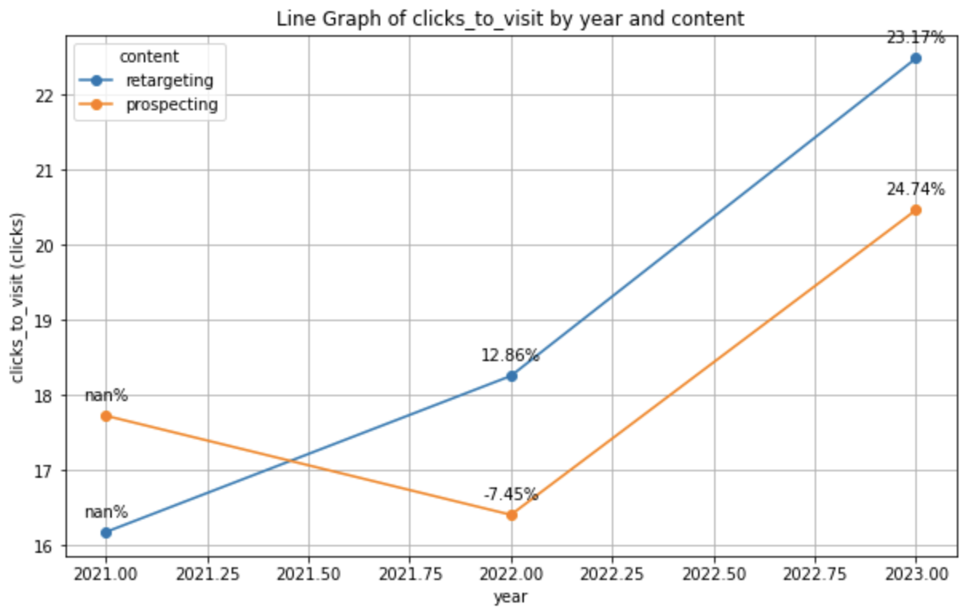
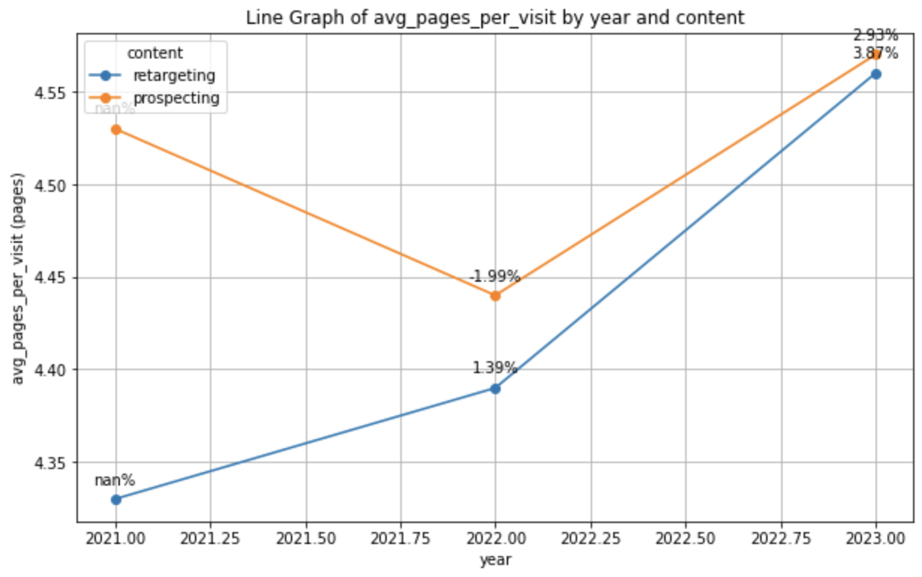
Display Subchannel - Consideration Metrics
2 more clicks on average to generate a visit for retargeting display ads
Highest clicks to visit for both content types
Between 4 and 5 pageviews per visit for both content types
Very little change since 2021

Slide 10
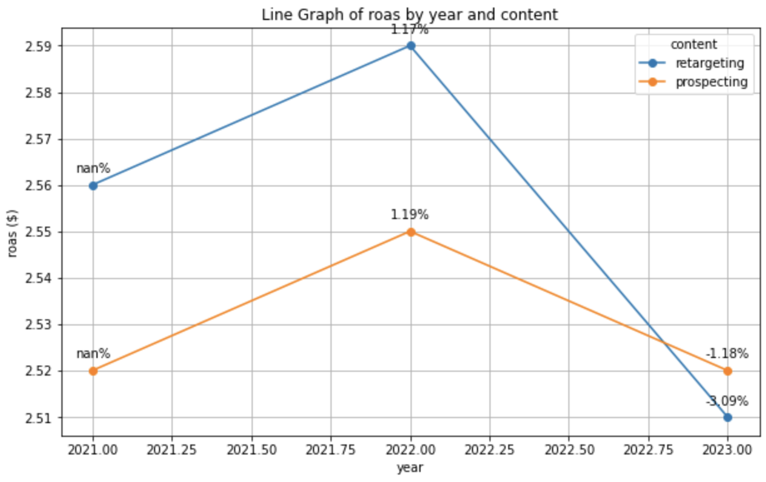
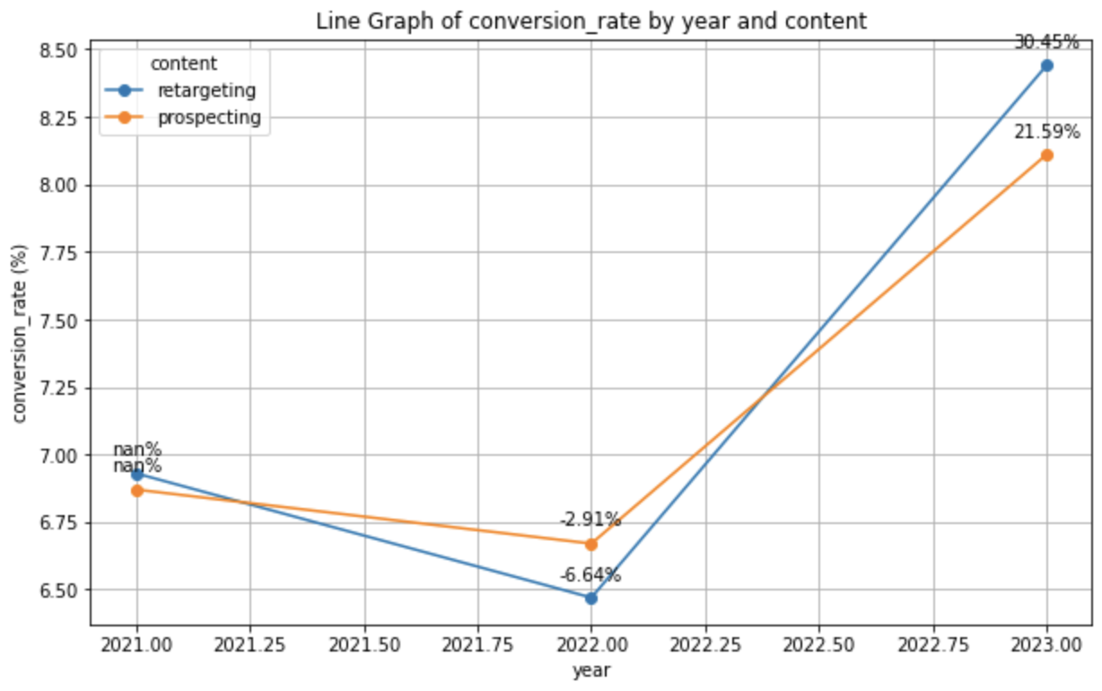
Display Subchannel - Conversion Metrics
2023 has lowest return on ad spend
Prospecting’s increase in click through rate does not align with decrease in ROAS
2023 has highest conversion rate
Definitions of conversion need to be evaluated

Slide 11
Opportunities for Improvement
Insights
Issues
Recommendation
Insights
Issues
Issues
…
Conversion - highest conversion rate in 2023 but also lowest ROAS
Quality and definitions of conversion
Evaluate conversion tracking systems and re-evaluate conversions
(Prospecting)
Acquisition - increased click through rate for prospecting
Consideration - increased clicks to view
Conversion - decrease on ROAS
Missed opportunities
Investigate if awareness brings conversions to other channels

Slide 12
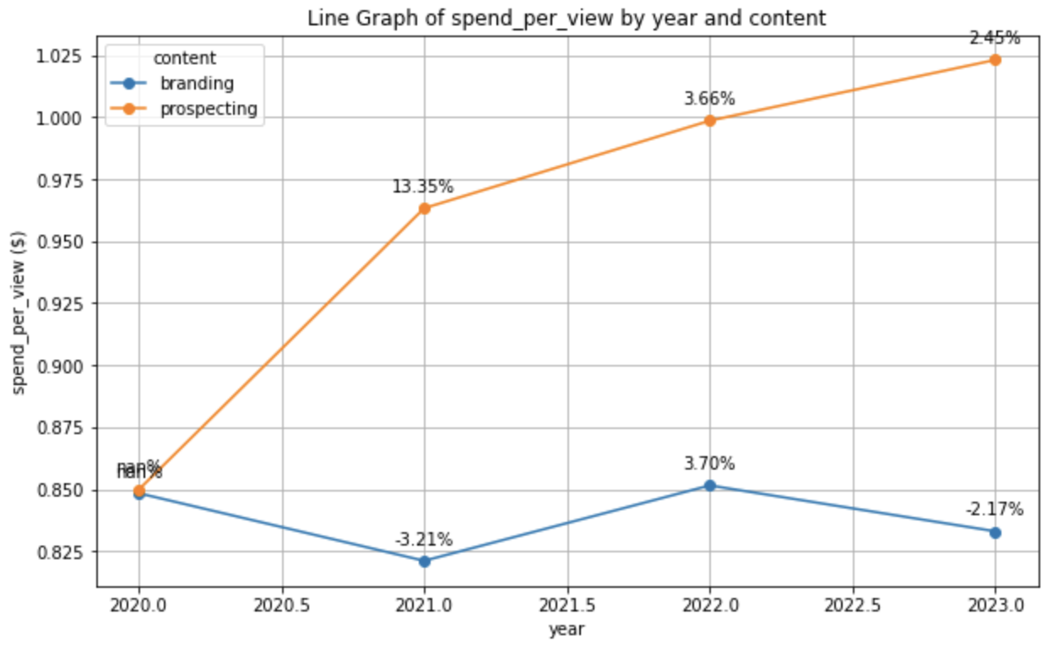
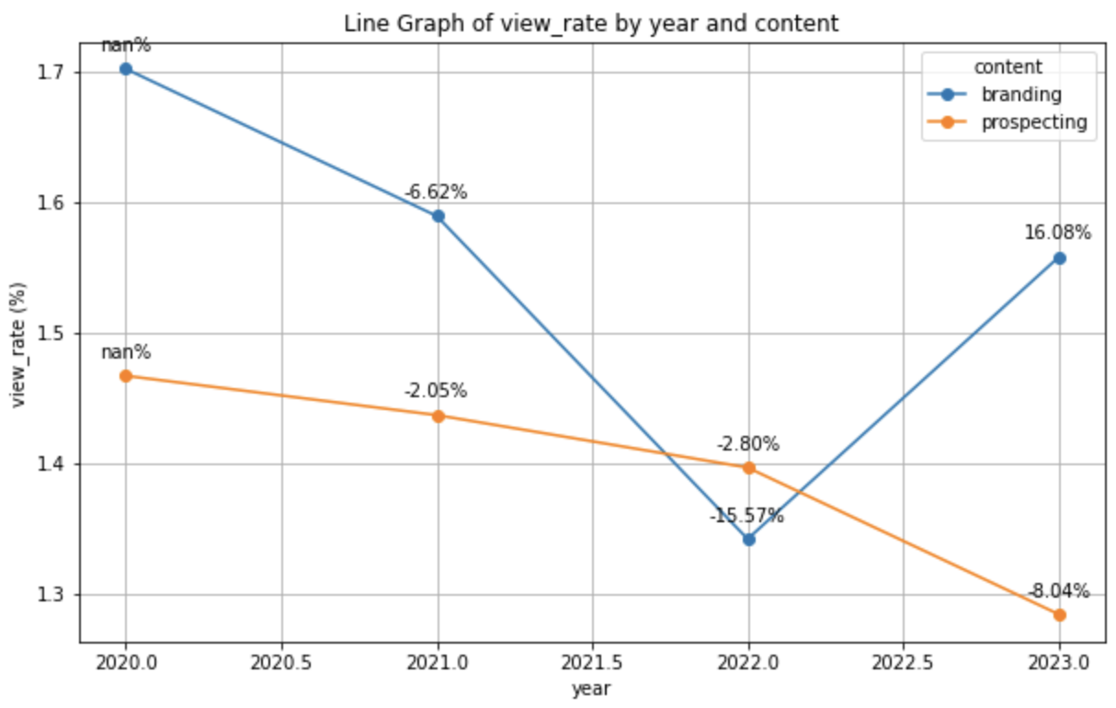
Video Subchannel - Acquisition Metrics
Prospecting spends 19 cents more than branding in 2023
Every impression gets at least 1 view
Branding spends less per view but has higher view rate

Slide 13
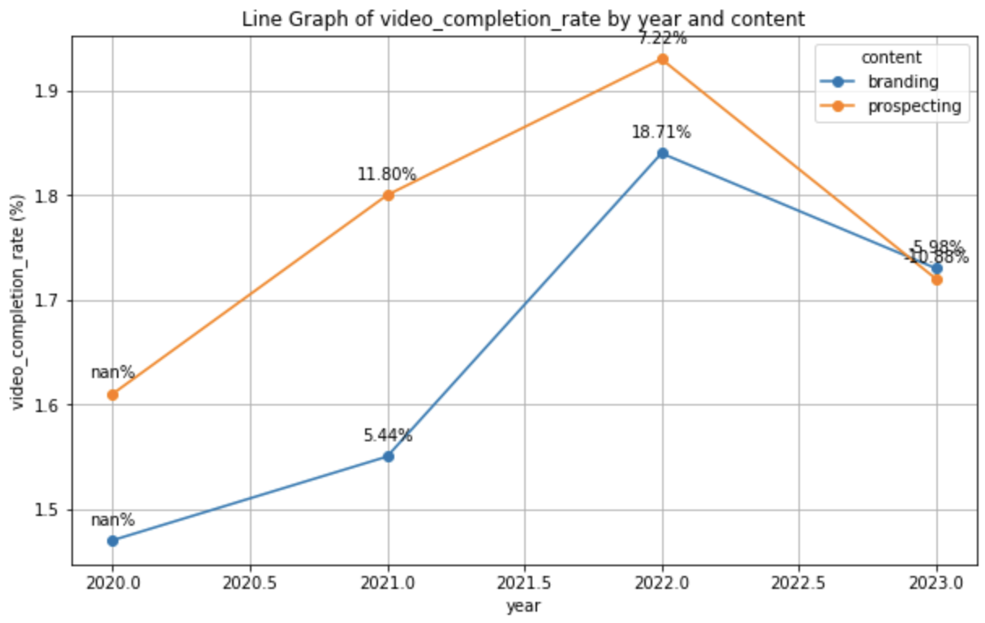
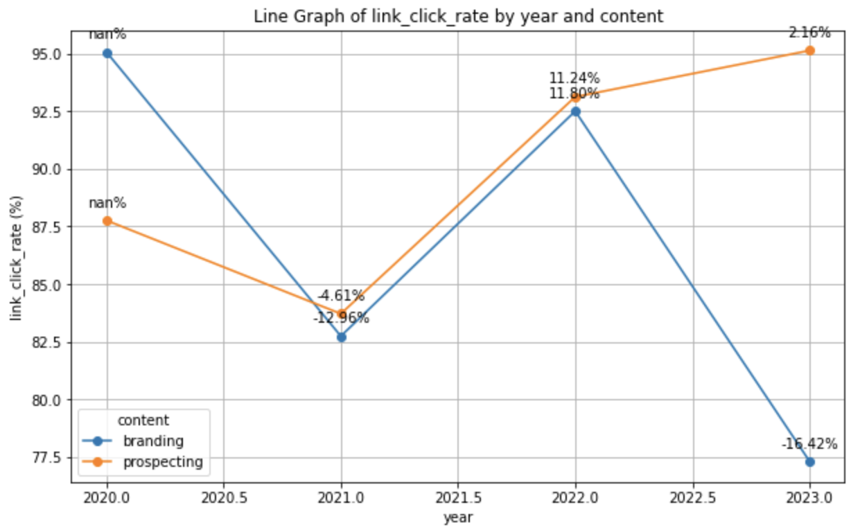
Video Subchannel - Consideration Metrics
There are more video completions than views
Similar performance for both content types
Decrease in view rate, but prospecting link click rates are highest in 2023
Increase in view rate, but link click rate has dipped

Slide 14
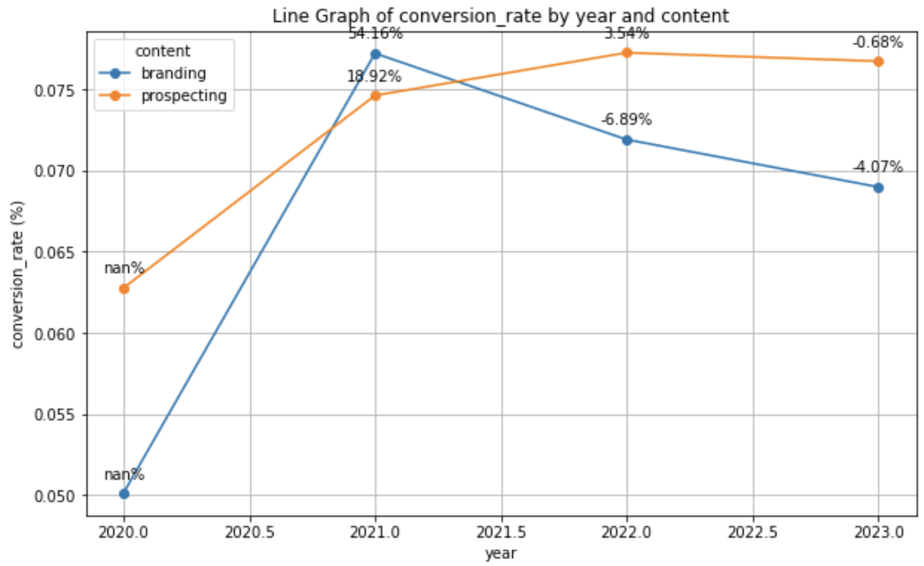
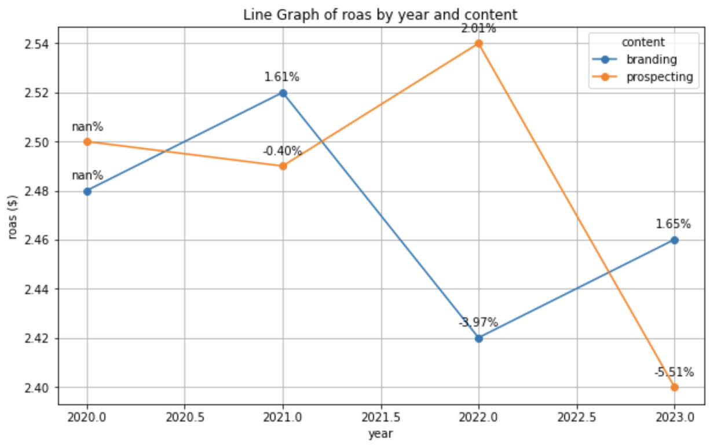
Video Subchannel - Conversion Metrics
Prospecting’s high link click rate and little change in conversion rate signal good content
Branding’s low click rate in 2023 may relate to decreased conversion rate
Prospecting’s decreased view rate may signal missed purchases
Branding’s ROAS increased nonetheless

Slide 15
Opportunities for Improvement
Insights
Issues
Recommendation
Insights
Issues
(Prospecting)
Acquisition - spend per view is higher but view rate is lower
Consideration - higher link click rate……
Conversion - lower ROAS
Issues
Thumbnail/first few secs or targeting issues
Customer Segmentation Analysis
(Branding)
Consideration - lower link click rate……
Conversion - higher ROAS
Weak messaging or exhausted content
Feedback and A/B Tests

Slide 16
Evaluating the Analysis
Acquisition
Money is not the only goal. Expanding reach and awareness are important too.
Consideration
Conversion
Unfair comparisons between channels with different purposes

Slide 17
Personal Takeaways
Different perspective on prospecting content
Reach and awareness are important too
Unfair comparisons between channels with different purposes

